Slide 1
The challenges of building the European Monetary Union Summer School 2015
Prof. Dr. Hansjörg Herr
Berlin School of Economics and Law

Slide 2
Structure
Economic situation
The foundation of a neoliberal version of the European Monetary Union (EMU)
Problems in detail
Reform options

Slide 3
Real GDP growth rates, 2000-2014
Source: AMECO Database (2015)

Slide 4
Real GDP, 2000-2014 (index 2000=100)
Source: AMECO Database (2015)

Slide 5
Unemployment rate, 2000-2014
Source: AMECO Database (2015)

Slide 6
Inflation rate, 2000-2014
Source: OECD Statisics (2015); Eurostat (2015)

Slide 7
The mislead construction of the EMU
European integration in the 1980s and 1990s as market radical project
The slogan was “the market solves all problems”
Supply side policy in the centre
No project of a social Europe
Competition between different country specific institutions - with the danger of a race to the bottom
Illusion of a monetary union without political union
Monetary unions need state-like institutions to be stable
EMU as a project of elites and capital
The Maastricht treaty form 1992 had very week elements of building a European State, but even these were later forgotten
Common foreign and security policy
Integration in the field of justice and home affairs
Strengthening fiscal rules was in the centre beginning with the Stability and Growth Pact 1998

Slide 8
Example of lack of institutions in the EMU Wage coordination and incoherent crisis management
A monetary union needs wage co-ordination of the different regions in the union
Without the instrument of the exchange rate wage and productivity development becomes important for regional price competitiveness
Not to change price competitiveness regional wages should increase according to the following formula:
increase in nominal wages = increase of regional productivity + increase of trend productivity

Slide 9
Nominal wages, 2000-2014 (index 2000=100)
Source: Author´s calculation based on AMECO Database (2015)

Slide 10
Nominal unit labour costs, 2000-2014 (index 2000=100)
Source: Author´s calculation based on AMECO Database (2015)

Slide 11
Countries with too high wage increases like Greece and Spain lost their price competitiveness before 2007
Countries with too low wage increases like Germany increased their price competitiveness
At the same time countries with relatively high wage increases realised relative high GDP growth (real estate bubble in Spain, fiscal expansion in Greece)
Countries with typically lower wage increases realised relatively lower GDP growth rates (export driven economies like Germany)
Consequence of both effects: High current account imbalances in the EMU

Slide 12
Current Account Balances in % of GDP
Source: Eurostat (2015)

Slide 13
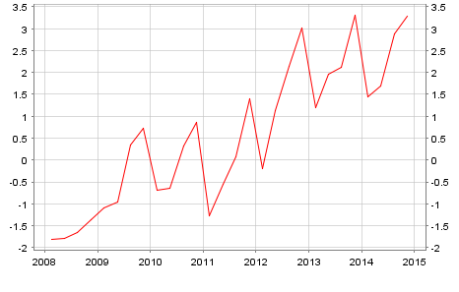
EMU current account in per cent of EMU GDP
Source: ECB

Slide 14
How to solve dysfunctional wage developments and current account imbalances in the EMU?
Good policies: symmetric adjustment via GDP growth and wage growth in current account surplus countries
Stimulation and relatively high growth in current account surplus countries (for example fiscal stimulation)
High nominal wage increases in surplus countries
Low nominal wage increases in current account deficit countries
Bad policies followed in Europe
Cut of wages in current account deficit countries
Low or negative GDP growth in current account deficit countries
Consequences
Extreme and unnecessary suffering in current account deficit countries
Low GDP growth in the whole EMU
Deflationary dangers in the EMU – danger of a Japanese scenario

Slide 15
Example of lack of institutions in the EMU Lack of fiscal co-ordination and anti-cyclical policy
There was anti-cyclical fiscal policy in 2009
The double recession in 2011 and 2012 was caused by pro-cyclical fiscal policy
What is missing is European wide anti-cyclical fiscal policy
Austerity policy failed

Slide 16
Budget deficit/surplus in % of GDP, 2000-2014
Source: AMECO Database (2015)

Slide 17
Government debt in % of GDP, 2000-2014
Source: AMECO Database (2015)

Slide 18
Why austerity policy – especially pushed by Germany?
Believe in the wrong neoclassical economic model of austerity and radical market liberalisation
Take the chance to enforce a neoliberal regime for political and eco
Strategy to increase German economic dominance in the EMU (weaken the industrial base in crises countries)

Slide 19
Example of no coherent regulation of the financial system No sufficient regulation of the financial system
Financial systems from the 1970s on became more and more deregulated
There was no EMU wide regulation of the financial system before the Great Recession 2009
Examples:
Real estate bubble in Spain was allowed to develop
Ireland allowed all types of risky institutions and activities
German banks invested in toxic paper outside the EMU
There is no sufficient regulation of the financial system after the Great Recession
Mainly tax payer paid for the bail-out of financial institutions
The Banking Union realises joint supervision of banks in the EMU (but no clear mechanism to resolve banks, no joint deposit insurance)
The shadow banking system remains largely unregulated
The power of rating agencies did not change
Disturbing international capital flows are not controlled

Slide 20
Short-term policies in the EMU
Substantially higher wage increases in Germany and other surplus countries
Fiscal stimulation especially in Germany and other surplus countries
Interest rate are extremely low now and public investment highly advantages
Tax the rich and stimulate demand without additional public debt
EU growth program following a “Green New Deal”

Slide 21
Long-term reform options in the EMU / Institution building
A monetary unions is only stable within a political union / money is part of state building
To make the EMU stable transfer of power to the centre is needed
This implies a much more competences for the European Parliament
One model could be a
strong EMU Parliament,
the European Commission becomes a government elected by the parliament,
State Council becomes a Second Camber

Slide 22
Fiscal union
EMU taxes - let us say 30% of income and value added tax goes to the centre plus a financial transaction tax
EMU wide industrial policy for a sustainable development
Elements of a transfer union
Centre carries out anti-cyclical fiscal policy
Limited room for budget deficit at member states of the EMU
….

Slide 23
Wage co-ordination
EMU minimum wage (regionally differentiated)
Support of EMU wage negotiation and coordination
Joined wage bargaining in Germany and France, Spain…
Creation of European unions and employers’ associations
….

Slide 24
Financial market regulation
Establishment of a segmented financial system or complete regulation of shadow financial institutions
Policy of externally balanced current account of the euro area
Managed floating and international capital controls
Important role for public and cooperative banks
….

Slide 25
Social union
EMU unemployment insurance
EMU minimum wages
Minimum social standards in all EMU countries
….

Slide 26
Thanks

Slide 27
Literature
S. Dullien, H. Herr Christian Kellermann, Decent Capitalism. A Blueprint for Reforming our Economies, London: Pluto Press 2011.
H. Herr, M. Kazandziska, Macroeconomic Policy Regimes in Western Industrial Countries, London: Routledge 2011.
H. Herr, Making an Unstable Financial System Work: Reform Options, in: International Journal of Labour Research, Vol. 3, 2011, 133-156, online available.
H. Herr, G. Horn, Wage Policy Today, Global University Working Paper, 2012, No. 16, online available.
H. Herr, From Financial Crisis to Depression and Deflation, GURN Policy Brief No.1, January 2009, online available.
H. Herr, The Labour Market in a Keynesian Economic Regime: Theoretical Debate and Empirical Findings, in: Cambridge Journal of Economics, 2009, vol. 33, 949-965.
H. Herr. The European Central Bank and the US Federal Reserve as Lender of Last Resort. Panoeconomicus, 2014, 1, Special Issue, pp. 59-78, 2014.
H. Herr, B. Ruoff, Wage Dispersion as Key Factor for Changing Personal Income Distribution, in: Journal of Self-Governance and Management Economics, vol. 2(3), 28–71, 2014.
N. Dodig, H. Herr, Current Account Imbalances in the EMU: An Assessment of Official Policy Responses, Panoeconomicus, 2015, vol. 62, 193-216.
N. Dodig, H. Herr, : Financial Crises Leading to Stagnation – Selected Historical Case Studies, in: E. Hein, D. Detzer, N. Dodig (eds.), The Demise of Finance-dominated Capitalism, Cheltenham, Edward Elgar 2015.

Slide 28
Supplementary material

Slide 29
Policies against the crisis from 2010 - three big mistakes
One-sided Internal devaluation of current account deficit countries via cutting nominal wages
No symmetric adjustment with substantially higher wage increases in Germany and other surplus countries
Deflation in crisis countries increased the real debt burden (no lesson learned from the Great Depression in the 1930s)
Not much as a surprise this policies pushed the EMU in a deflationary constellation
Right and left hand of the ECB obviously did not know what they did
Brutal fiscal austerity
Cut demand in a situation of a lack of demand will lead to bigger and bigger crisis (usually this learn economic students in the second semester)
Budget and debt targets could not be achieved
Enforcement of structural reforms – what kind of reforms?
There are different visions of structural reforms
Troika: deregulation, liberalisation and privatisation – the old failed Washington Consensus was Troika’s guideline
Reduce tax evasion, fair burden sharing, institutions for macroeconomic coordination, etc. was not part of the adjustment programme
Countries under the Troika lost all democratic rights
There were no policies included to stimulate demand, for example investment and consumption
It was a completely asymmetric adjustment process maximising costs in crisis countries
Not the faintest idea that a monetary union is a system with interdependences

Slide 30
European Central Bank as the reluctened rescuer of the Euro
ECB took much too late over the function of lender of last resort for public households
"The ECB is ready to do whatever it takes to preserve the Euro. And believe me, it will be enough.“ Mario Drahi, July 2012
However, the ECB helps under the condition the country follows recommendations of the Troika

Slide 31
ECB financed capital flight and current account deficits in crisis countries when capital imports stopped (TARGET II balances)
Source: Institute of Empirical Economic Research (2014) based on Individual Central Banks Data

Slide 33
Labour productivity, 2000-2013 (index 2000=100)*
Source: Author´s calculation based on OECD Statistics (2015)
*Labour productivity measured as GDP per person employed.

Slide 34
Sources: ECB, AMECO-Database, Ecowin.
34
Notes:
34

Slide 35
Key policies against the crisis in the EMU
June 2010, founding of EFSF (European Financial Stability Facility)
Volume €440 billion
IMF added €250 billion
Forces countries to austerity measures and structural reforms
2012 European Stability Mechanism (ESM) substitutes EFSF (volume €500 billion)
Possibility of leveraging the EMS

Slide 36
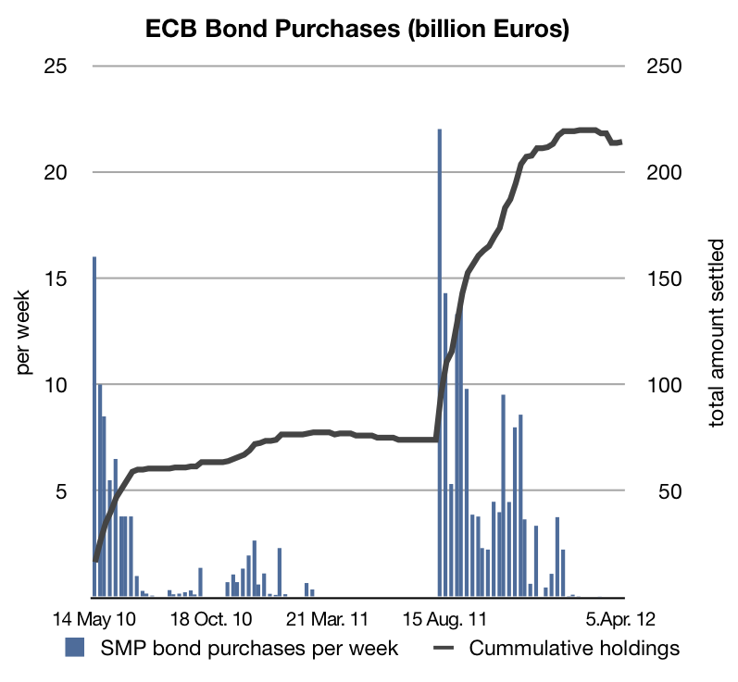
ECB bond purchases under the Securities Markets Programme (SMP)
Source: ECB (2012), Weekly Statements
36

Slide 37
Money market interest rates in the USA and EMU 2007-2013
* For ECB until October 2008 minimum bid rate. Source: FED selected interest rates; ECB key interest rates.

Slide 38
Total assets Fed and ECB, trillion national currencies, 2003-2013
Source: FED Data Download Program (2013), ECB Statistical Data Warehouse (2013).

